Slide 1

ZeroML
Next Generation AutoML Language
- Monirul I. Mahmud

Slide 2
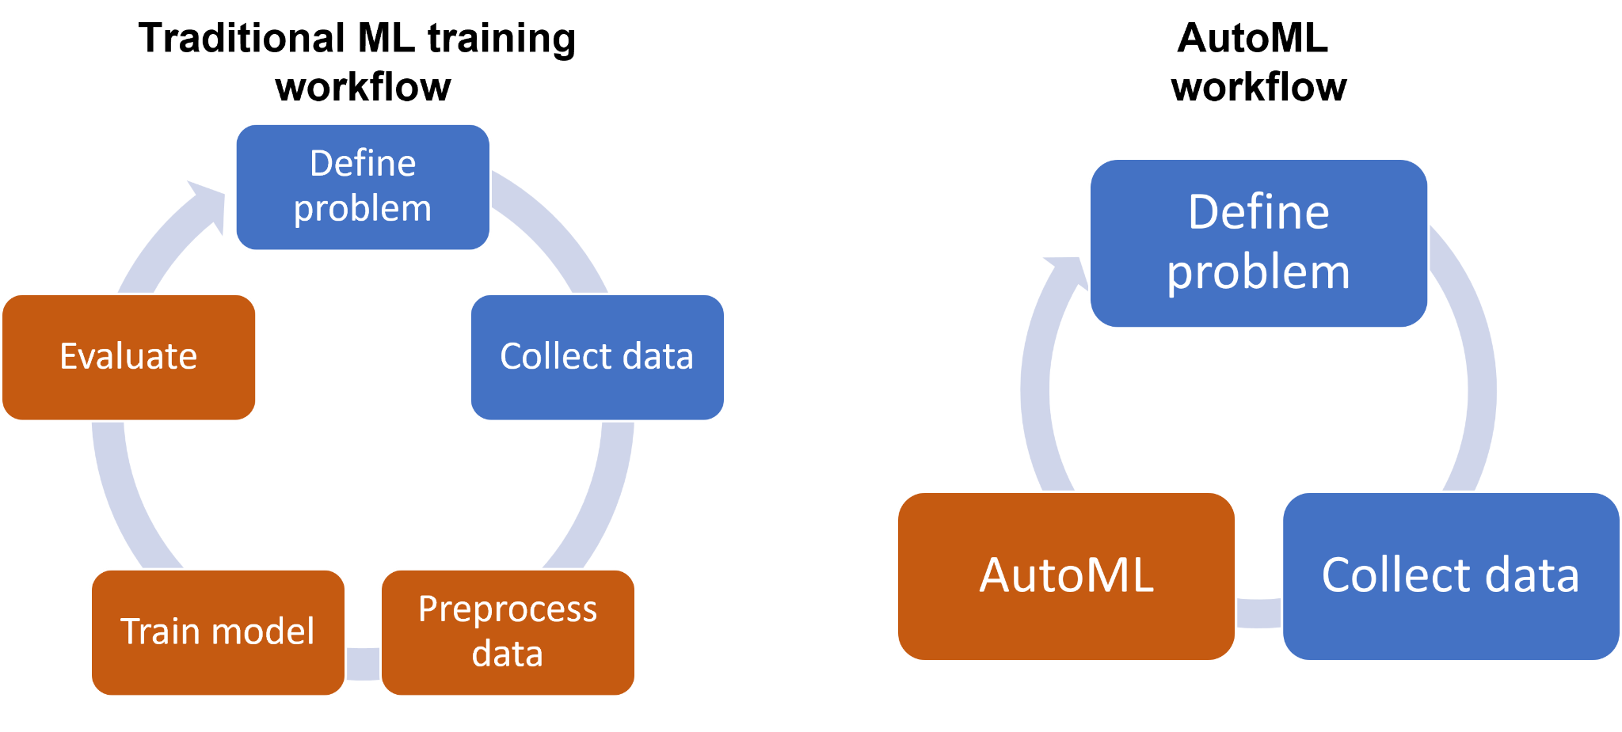
AutoML
(Automated Machine Learning)

Slide 3
Existing Language & Problems
Language / Library | Limitations
Python | Needs external libraries (TPOT, Auto-sklearn, PyCaret) High parallelism overhead slows large searches.
R (Caret, H2O.ai) | Less mature AutoML ecosystem compared to Python. Difficult library integration. Limited deep learning support.
Julia | Smaller community and fewer libraries. Limited documentation and examples. Fragile pipeline handling in large tasks.
Key Observations:
External libraries are always required.
Pipeline fragility and runtime inefficiency are common.
Customization is either complex or extremely limited.
Parallelism and scaling often remain weak, especially in Python and R

Slide 4
ZeroML Language as a Solution
Existing Problem | Solution
Manually install, configure, and update external packages | ZeroML need no separate installation. Always version matched and optimized.
Current libraries mix data cleaning, feature engineering, model selection all into one Giant Block, making debugging extremely hard. | Modular separate customizable AutoML components: DataCleaner, FeatureEngineer, ModelSelector, Deployer.
Search instability in AutoML engines: PyCaret: efficient but slightly less accurate. TPOT: completed only ~43% of tasks (timeout, memory errors) | ZeroML will have Native timeout handling, checkpointing, and memory-aware search strategies. Automatically fallback to lighter models when resources are constrained.
Deployment - After AutoML finishes, users need to manually export and adapt the model for production (export .py file, retrain, rebuild). | Deployment-ready artifacts by default. One command for API, serverless, or on-device deployment

Slide 5
Target Domains & Users
Business Analysts - Sales prediction, customer churn, credit scoring, market analysis.
Scientists, Doctors, Marketers, Analysts who know their domain but are not expert coders.
Students learning machine learning can focus on concepts instead of complex API usage.
Data engineers and ML engineers who need faster prototyping and production pipelines.
Researchers can quickly test hypotheses with high-accuracy models without worrying about low-level ML details.

Slide 6
Type of Language
Compiled for Efficiency:
Results in faster execution, better multithreading, and less runtime error compared to Python or R.
Optimize memory management for large datasets.
Multi-paradigm Programming Style:
Procedural: Straightforward AutoML workflows using ordered steps
(Load → Search → Deploy).
Object Oriented: AutoML components like DataCleaner, FeatureEngineer, ModelSelector, Evaluator & Deployer are objects, encouraging modular design.
1

Slide 7
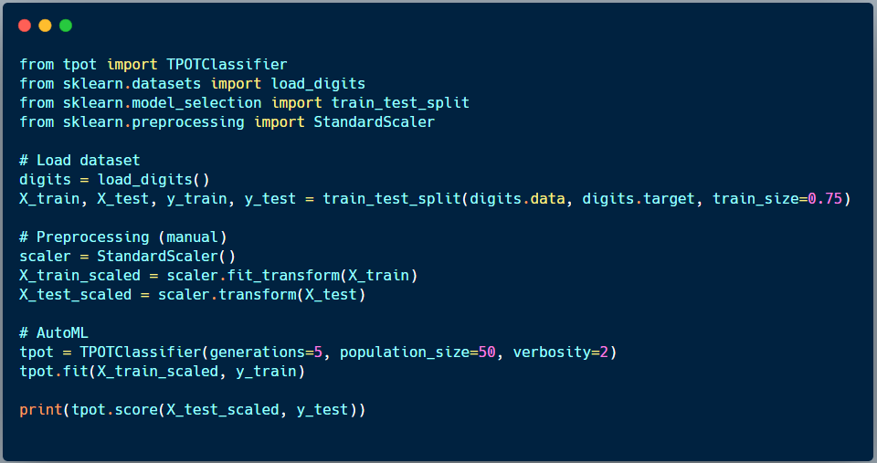
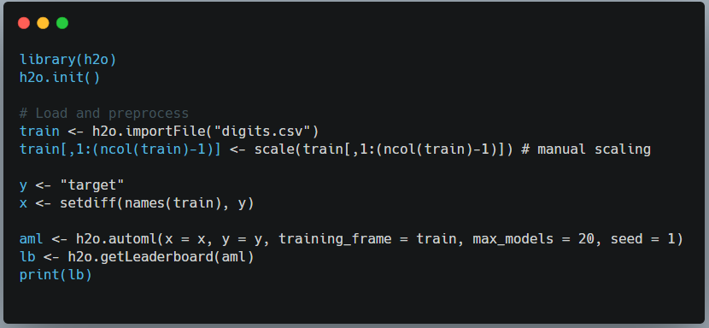
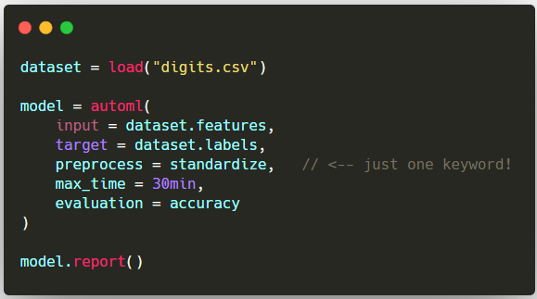
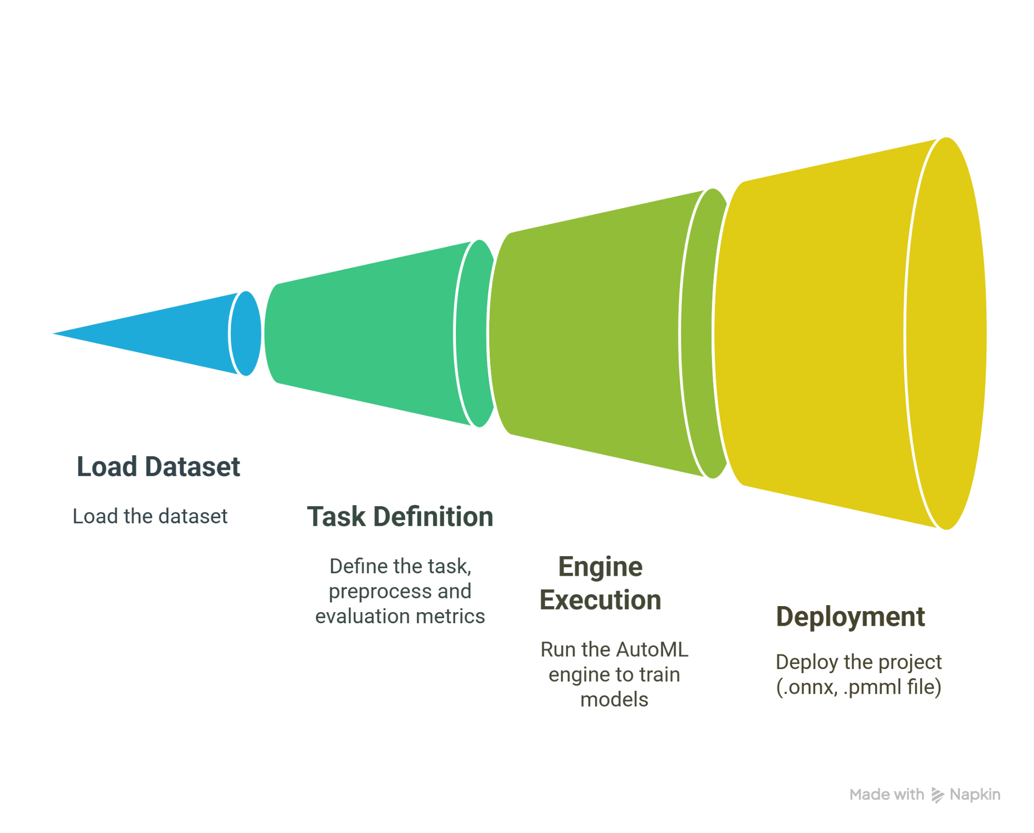
Code Snippets
Python AutoML (TPOT + Scikit-Learn)
R AutoML (H2O)
ZeroML →

Slide 8
Design Goals of ZeroML
Readability | Moderate. Still requires learning new syntax & patterns, making it slightly complex than beginner Python.
Writability | High. ZeroML workflows can be written in very few lines compared to Python or R.
Reliability | Moderate. ZeroML has No external library dependency, no environment mismatch errors. But Less support for custom transformer or a hybrid models.
Runtime Cost | Low. Compiled language runs faster than Interpreted language like Python and R.

Slide 9
Thank You

